Slide 1
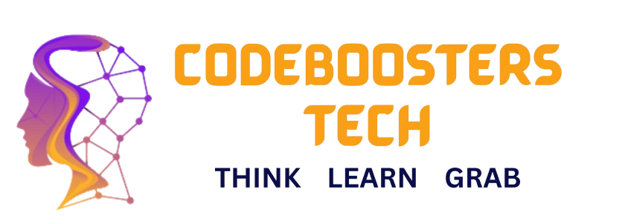

Agentic AI: Concepts & Frameworks
Introduction, Walkthrough, and Practical Overview

Slide 2
Introduction to Agentic AI
Agentic AI refers to AI systems that can act with autonomy, proactivity, and goal-directed behavior.
Unlike traditional AI, agentic AI can adapt, make decisions, and coordinate actions without constant human input.
Example: A travel planning agent that books flights and hotels proactively based on your preferences.

Slide 3
Agentic vs Non-Agentic AI
Non-Agentic AI: Reactive systems, respond to direct inputs only.
- Example: A calculator app responds only when you give input.
Agentic AI: Autonomous, proactive systems that pursue goals.
- Example: A personal AI assistant that schedules meetings before conflicts occur.

Slide 4
Core Properties of Agentic AI
Autonomy – Operates independently without step-by-step instructions.
Proactivity – Anticipates needs and takes initiative.
Goal-directed behavior – Works toward defined objectives even under uncertainty.
Example: AI that monitors stock markets and autonomously buys/sells based on your portfolio goals.

Slide 5
Single vs Multi-Agent Systems
Single-Agent: One AI system working toward goals.
- Example: ChatGPT as a personal tutor.
Multi-Agent: Multiple agents collaborating or competing to achieve goals.
- Example: AI customer support team with specialized bots (billing, tech, feedback).

Slide 6
Types of Agentic Systems
Reactive Agents – Respond to current stimuli, no memory.
- Example: Game AI that reacts instantly to player moves.
Deliberative Agents – Use reasoning, planning, memory.
- Example: AI that plans a week-long travel itinerary.
Hybrid Agents – Combine reactivity with deliberation.
- Example: Self-driving cars that react to traffic (reactive) while planning routes (deliberative).

Slide 7
Frameworks for Agentic AI
Several frameworks help build agentic systems by providing tools for autonomy, memory, reasoning, and orchestration.
We will cover:
• OpenAI SDK
• CrewAI
• LangGraph
• AutoGen

Slide 8
OpenAI SDK
Provides easy access to GPT models via Python/JS APIs.
Can be extended with functions, memory, and retrieval.
Useful for building chatbots, assistants, or single-agent prototypes.
Example: Customer support chatbot using GPT-4 + company knowledge base.

Slide 9
CrewAI
Focused on building multi-agent systems.
Agents act like team members (roles: researcher, planner, coder, writer).
Supports orchestration, coordination, and delegation.
Example: AI research team – one agent gathers papers, another summarizes, another drafts reports.

Slide 10
LangGraph
Graph-based orchestration for LLM agents.
Allows chaining, branching, and feedback loops.
Excellent for workflow automation and complex pipelines.
Example: A document processing pipeline – ingestion → summarization → question-answering.

Slide 11
AutoGen
Multi-agent conversation framework by Microsoft.
Agents communicate with each other to solve tasks collaboratively.
Encourages human-in-the-loop setups.
Example: Software development assistant – one agent writes code, another reviews, another tests.

